Slide 1
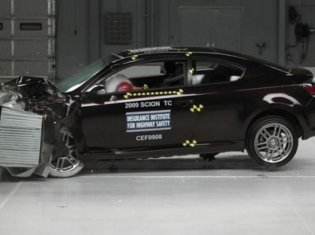
Newton’s First Law of Motion
This lesson will introduce you to the first of three laws of dynamics
These laws are the fundamental laws of Dynamics. With them, you
can predict how an object will move when under the influence of
forces.

Slide 2
Learning Goals
By the end of this lesson, you will be able to:
explain the law of inertia
state and explain Newton’s 1st Law of Motion
identify when the 1st law applies in certain situation
state examples of the 1st law

Slide 3
Success Criteria
Can I:
explain the law of inertia
state Newton’s 1st Law
explain situations involving the 1st law
apply the 1st law to identify the type of motion of an object

Slide 4
Law of Inertia
Aristotle believed that a force is necessary to keep an object in motion.
Galileo disagreed: He believed that objects want to maintain their current state of motion.
Galileo discovered the law of Inertia
Inertia is an object ability to resist change in motion
Objects at rest want to stay at rest. Objects
moving with constant velocity want to continue
moving with constant velocity

Slide 5
Mass is a measure of an objects inertia.
Mass is measured in kilograms, kg. The more mass
an object has, the more inertia it has.
Thus more massive objects have a higher resistance
to changes in motion than less massive objects

Slide 6
Newton’s 1st Law of Motion
All objects will remain in a state of rest or continue to move with constant velocity unless acted upon by an unbalanced external force.
The first law states that an unbalanced force is
necessary to change the velocity of an object. ie.
causes objects to accelerate.
It also states that if the forces on an object are
balanced (or zero), then the object is either at rest or
moving with constant velocity.

Slide 7
If the forces are balanced on a object then:
The object is at rest; or
The object is moving at constant velocity
Without more information, we can’t tell which of
the above two the object is doing

Slide 8
PRACTICE Problem
1. Who believed that moving objects have a natural tendency to come to rest?
Aristotle
Galileo
Newton
Einstein
Lamonica

Slide 9
PRACTICE Problem
2. Who believed that moving objects have a natural tendency to continue in their state of motion?
Aristotle
Galileo
Newton
Einstein
Lamonica

Slide 10
PRACTICE Problem
3. Who believed that objects at rest have a natural tendency to stay at rest?
Aristotle
Galileo
Newton
Einstein
Lamonica

Slide 11
PRACTICE Problem
4. What is the definition of inertia?
The tendency of a moving object to stop
The tendency of a moving object to stay moving
The tendency of a stopped object to stay stopped
The tendency of an object to resist change in motion
The tendency of objects to not move

Slide 12
PRACTICE Problem
5. What is the unit of inertia?
i
N
kg
m/s²
kg m/s²

Slide 13
Examples of the 1st Law
Crash test dummies
Magician’s table cloth
Car on ice
Mack Trucks
Many more

Slide 14
PRACTICE Problem
6. Which of the following would not illustrate Newton’s First Law of Motion?
An asteroid moving at constant vel through space
A textbook at rest on a table
A tissue box in the back seat of a car slides forward when the brakes are applied
A rocket accelerates upwards as its engines fire
A student kick her boots against a step to remove snow stuck to the sole.

Slide 15
HOMEWORK
Read Section 3.2
Review Tutorial 1 and 2
Questions 1 – 5 pg 126
2 – 10 pg 129

